Slide 1
Windows Azure Migrating Applications and Workloads
Speaker
Title
Organization

Slide 2
Agenda
Application Migration
Imaging Virtual Machines
Deploying Enterprise Apps

Slide 3
Application Migration

Slide 4
Migration Approaches
Build Virtual Machine in the Cloud
Lowers upload time and dependency risk
Requires upload and installation of application and data
Migrating an Existing Virtual Machine
Application, Configuration and Data in an installed Working State
Requires uploading a large amount of data and a higher risk of drivers or other hardware dependencies on VM not available in the cloud
Notes:
Slide Objective:
There are essentially two ways of migrating an application to the cloud.
Notes:
The first is to attempt to migrate an entire existing virtual machine. For HyperV users this involves uploading the VHD(s) and then configuring a virtual machine to use the disks.
For non-HyperV users this means finding a method of converting either their running machine to a VHD OR their current virtualization format to VHD. Many solutions exist to both.
The second option comes down to configuring and booting the VM in the cloud directly. Uploading the application and data via Windows Azure storage and configuring the VMs.

Slide 5
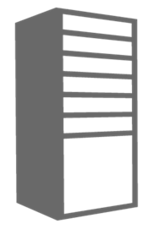

Migrating a Multi-VM Application
Cloud Service Acts as a Networking Boundary
All VMs in the same service can communicate directly
Name resolution between VMs is automatic with Windows Azure provided DNS
Cloud Service
Name: myapp1.cloudapp.net
Load Balancer
Public IP
Virtual Machine
VM Name: iisvm1
10.1.5.6
Virtual Machine
VM Name: iisvm2
10.1.5.7
DIP
DIP
DIP
Virtual Machine
VM Name: sqlvm1
10.1.5.8
Notes:
Slide Objective:
In the Windows Azure management portal there are two methods of creating a VM.
Notes:
Quick create always creates a new cloud service but it does not display the cloud service. Each time this wizard is used a cloud service with a single VM will be created.
Gallery method gives the option of creating a Stand Alone VM or the option to Connect to an existing VM.
Stand alone VM gives similar behavior to Quick Create. A new cloud service will be created with the new VM being the sole occupant.
Connect to an existing VM allows you to add a single VM to an existing cloud service.
All VMs within the same cloud service can directly communicate with each other over the network. If they are not deployed inside of a virtual network they will also have name resolution by default with Windows Azure provided DNS. If deployed into a VNET the requirement is shifted to the user to provide name resolution.

Slide 6
DEMO
Migrating a Web Farm
Notes:
Slide Objective:
Demo
Notes:
See demo script DEMO-MigratingWebFarm

Slide 7
Virtual Machine Migration
Windows Azure Supports VHD File Format
Other formats will have to be converted or migrated before upload
Upload Existing VHDs using CSUpload.exe
Supports Resuming Failed Transfers
Converting from Dynamic to Fixed Disk on Upload
Efficient Upload – does not send empty bytes
Things to Do Before Uploading OS Disk
Enable Remote Access
Notes:
Slide Objective:
Explain nuances of migrating VMs
Notes:
Dynamic Disks are not supported directly in the cloud. Before uploading a dynamic disk it will have to be converted into a fixed disk.
CSUpload.exe supports converting the dynamic disk to fixed on upload. The benefit is unused blocks are not uploaded so it is a more efficient/optimized upload.
CSUpload.exe also supports resuming a failed transfer.

Slide 8
Migrating a Simple Virtual Machine
Migration Steps
1) Upload VHDs
CSUpload or other Tools
2) Create VM
OS Disk=APP-OS.vhd
3) Configure Data Disks
Data Disk 1 = APP-Data.vhd
Data Disk 2 = App-Logs.vhd
4) Adjust App for Drive Letters
5) Add Endpoint(s)
80, TCP, http
443, TCP, https
Cloud Service
Name: myapp1.cloudapp.net
On-Premises Virtual Machine
Machine Name: APPSRV1
Memory: 8 GB
Cores: 4
Ports: 80/443 for http/https
Deployment
Slot Production
Virtual Machine
Role Name: appsrv1
4 Cores
7 GB Ram
Guest: C:\
Host: C:\VMs\APP-OS.vhd
Windows Azure
Storage
TCP Endpoints 80 and 443
Guest: D:\
Host: D:\VMs\APP-Data.vhd
Guest: C:\
WAStorage\VMs\APP-OS.vhd
Guest: E:\
Host: E:\VMs\APP-Logs.vhd
Guest: E:\
WAStorage\VMs\APP-Data.vhd
Guest: F:\
WAStorageVMs\APP-Logs.vhd
Notes:
Slide Objective:
This animation is a simple example of the steps needed to migrate a VM running in HyperV on premises to Windows Azure.
Notes:
The reason for the adjustment in drive letters is the Windows Azure VM exposes the local server physical storage as the D: drive on Windows. This location should be considered temporary because it is not backed by Windows Azure storage. Since the D: is taken VMs that are currently using the D: drive will need to be adjusted on upload.

Slide 9
DEMO
Migrating a Virtual Machine
Notes:
Slide Objective:
Show how you can migrate a virtual machine with System Center App Controller
Notes:
Use DEMO_MigrateSharePoint (DemoMate)

Slide 10
DEMO
Using CSUpload
Notes:
Slide Objective:
DEMO
Notes:
See DEMO-UsingCSUpload

Slide 11
Imaging Virtual Machines

Slide 12
Imaging VMs in the Cloud
Cloud
Base.VHD
Blob Storage
Identical/similar deployment instances using common OS image as start
Boot
VM
Blob Storage
Customize
VHD
Generalize
VHD
Capture
VM
Capture VM Saves Customized Image to Your Image Library
Notes:
Slide Objective:
Explain how to create an image in the cloud
Notes:
This use case is about using the capture feature of IaaS to create OS images. The first part you start with a base vhd that you then custom with software binaries, registry settings etc.. You run sysprep.exe and generalize/shutdown the OS. You can then upload it if coming from on-premises or just click the capture button if you created the VM in the cloud.
Capture allows you to take a generalized VM and save the underlying VHD as a new image in your image library.

Slide 13
DEMO
Custom Images
Notes:
Slide Objective:
DEMO
Notes:
See DEMO-ImagingVMs

Slide 14
Deploying Enterprise Applications

Slide 15
Windows Azure Virtual Network
Persistent IP Address Requirements
Virtual Machines deployed into a virtual network have an infinite DHCP lease.
Hybrid On-Premises Cloud Apps
Requirement for connectivity between your data center and the public cloud.
Connectivity between cloud services.
Deploying Active Directory in the Cloud or connecting a PaaS to IaaS Service.
Corpnet
Windows Azure
VM 1
VM 2
Subnet 1
Subnet 2
ROLE 1
Notes:
Slide Objective:
Quick reference of use cases for VNET
Notes:
Windows Azure Virtual Networks provide functionality above and beyond site to site networking.
VNETs also provide persistent IP addresses through an infinite DHCP lease (not static but effectively the same thing).
VNETs also provide the capability of connecting cloud services in the same affinity group directly. This allows for scenarios like web and worker roles to virtual machines running services like SQL Server 2012 or SharePoint.

Slide 16

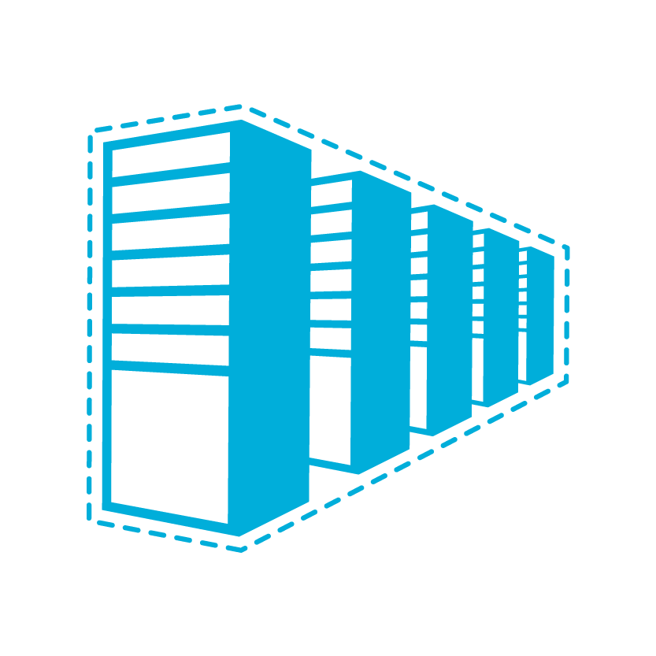
Domain Controller in the Cloud
Contoso.com Active Directory
Contoso.com Active Directory
Contoso Corp Network
The Virtual Network
in Windows Azure
SQL Servers
IIS Servers
Site to Site VPN Tunnel
AD / DNS
AD Replication
+ On Premises Resources
Gateway
AD / DNS
S2S VPN Device
AD Auth
IIS Servers
SQL Servers
Exchange
Load Balancer
Public IP
Notes:
Slide Objective:
Diagram depicting virtual machines in the cloud consuming Active Directory services from within the cloud as part of an existing forest.
AD replication will occur over the VPN tunnel.

Slide 17
Cloud Services Configuration for AD
Deploy DC in Separate Cloud Service
ADVNET
Cloud Service for AD Domains
Name: ad-cloudservice.cloudapp.net
Affinity Group: ADAG
Cloud Service for AD Clients
Name: app-cloudservice.cloudapp.net
Affinity Group: ADAG
Deployment
Virtual Network: ADVNET
DNS Ips: (On-Premise AD IP)
Deployment
Virtual Network: ADVNET
DNS Ips: 192.168.1.4
Virtual Machine
Role Name: ad-dc
Subnet: ADSubnet
IP Address: 192.168.1.4
DIP
Virtual Machine
Role Name: advm1
Subnet: AppSubnet
IP Address: 192.168.2.4
Notes:
Slide Objective:
Deploying multiple cloud services for a DC in the cloud
Notes:
The cloud service on the left holds a virtual machine running Active Directory. The DNS server IP address of this particular deployment could be pointing to an on-premise DC if it were part of an existing forest.
The cloud service on the right has the deployment DNS servers specify the IP address of the domain controller on the left. When VMs boot up in this cloud service they will inherit this setting and be able to resolve names in the domain – and join the domain.
Note: both cloud services are in the same virtual network.

Slide 18
DEMO
Deploying with Active Directory
Notes:
Slide Objective:
DEMO
Notes:
See DEMO-DeployingAD

Slide 19
Managing VMs

Slide 20
Managing Windows Azure VMs
Windows Azure Virtual Machines are not “different”
Existing Monitoring and Management Applications will continue to work
Connectivity Will Be Key
Using Windows Azure Virtual Networks to bridge the connectivity divide
Management Applications may have more streamlined solutions such as the System Center Gateway Service
For Azure Specific Automation Tasks Use PowerShell
Notes:
Slide Objective:
Management options for VMS

Slide 21
Scripting Capabilities
Full Support for IaaS
Windows Azure PowerShell Cmdlets
Cross Platform Scripting Built on node.js
Capabilities
Provisioning, Removal
Reboot, Start
Import and Export VM settings
Support for Windows and Linux VMs
Domain Join at Provision for Windows
Fully Customize VM with Data Disks and Endpoint Configuration
Automate Virtual Network Settings
Notes:
Slide Objective:
Highlight some of the functionality available to Windows Administrators to automate management / provisioning of virtual machines in the cloud.

Slide 22
DEMO
Scaling Up or Down
Notes:
Slide Objectives:
DEMO
Notes: See DEMO-ScaleUpDown

Slide 23
Summary
Application Migration
Imaging Virtual Machines
Deploying Enterprise Apps
Notes:
Slide Objective:
Summary of presentation

